Slide 1

Project:
Red Vs Blue
By: Darnell Antwine & Rishawn Blackwell

Slide 2
Table of Contents
This document contains the following sections:
01
Network Diagram
02
Red Team (Offense): Security Assessment
03
Blue Team (Defense): Log Analysis and Attack Characterization
Hardening: Proposed Alarms and Mitigation Strategies
04

Slide 3
Network Topology
‹#›

Slide 4
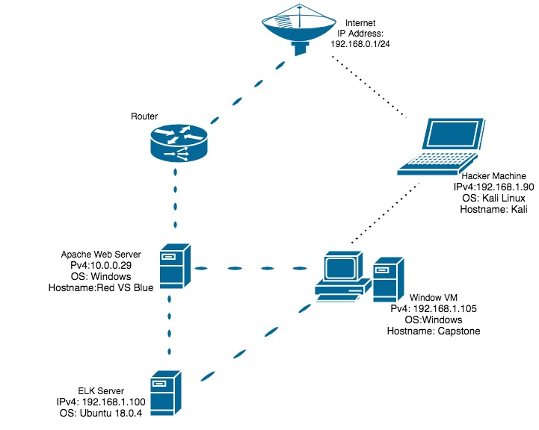
‹#›

Slide 5

Red Team
Security Assessment
‹#›

Slide 6
Recon: Describing the Target
Nmap identified the following hosts on the network:
Hostname | IP Address | Role on Network
Kali | 192.168.1.90 | Hackers Machine
Ubuntu 18.04 | 192.168.1.100 | Company Server
Capstone | 192.168.1.105 | Company Machine

Slide 7
Vulnerability Assessment
The assessment uncovered the following critical vulnerabilities in the target:
Vulnerability | Description | Impact
Weak Passwords | Strength of password is not strong enough | Allows attackers to easily access someone’s login information
Compromise Credentials | Privilege Escalation | allows attackers to gain access to sensitive credentials
Poor Encryption | The conversion of something to code or symbols so that its contents cannot be understood if intercepted. | Allows attackers to gain access to more sensitive data.

Slide 8
Exploitation: Weak Passwords
01
02
Tools & Processes
I used the tool Hydra to exploit and retrieve the password for ashton.
Achievements
The exploit allowed me to get gain further access into the company’s database using ashtons password.

Slide 9
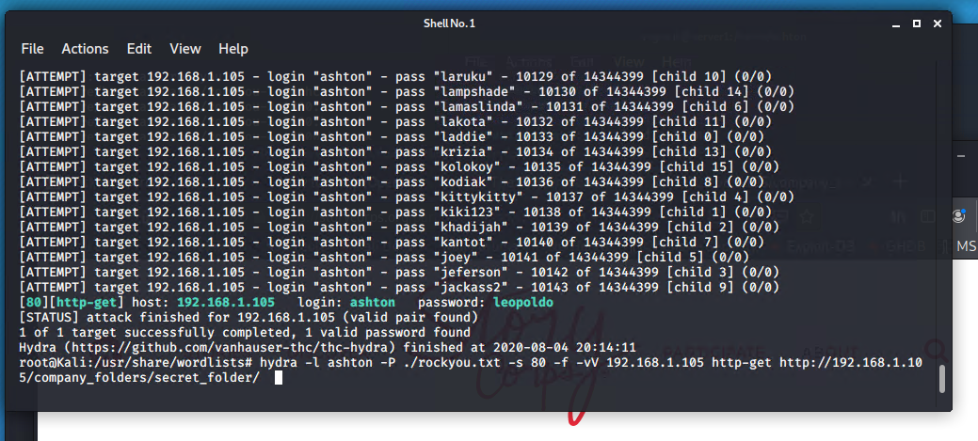

Slide 10
Exploitation: Poor Encryption & Compromise Credentials
01
02
Tools & Processes
Used Crackstation.net to crack the encrypted Hash found using Ashton’s login. Used WebDav. Used php-reverse-shell tool to gain access.
Achievements
Allowed further access into the company’s data by discovering, manager Ryan’s login credentials. And giving root access to Ryan’s credentials.

Slide 11
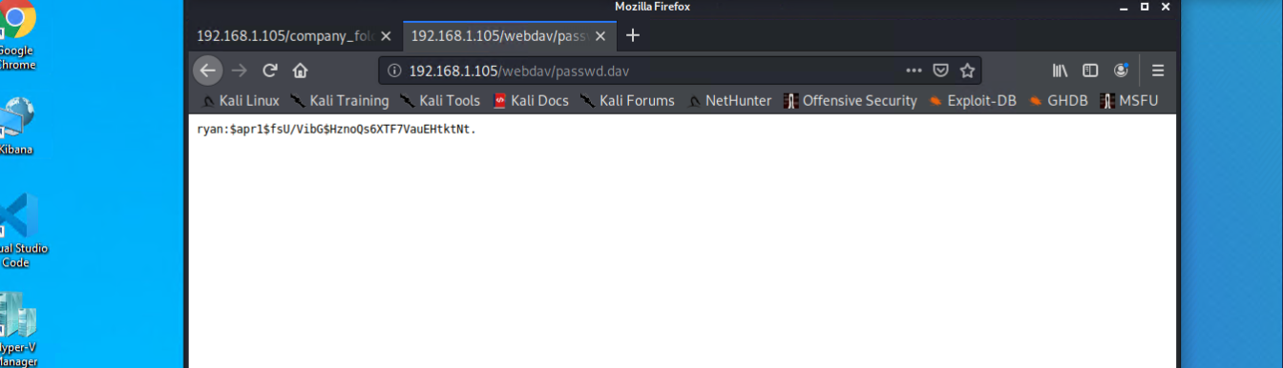
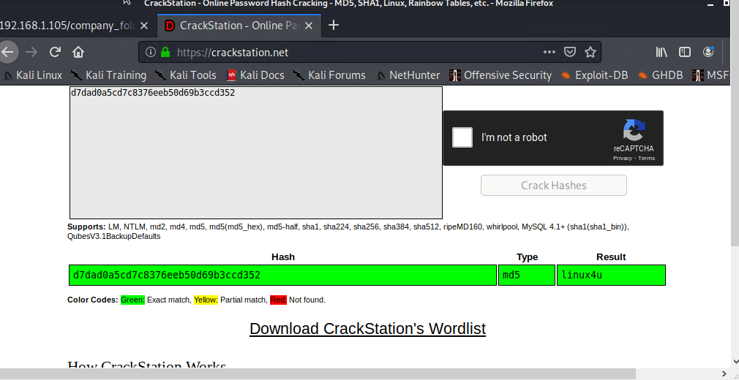

Slide 12
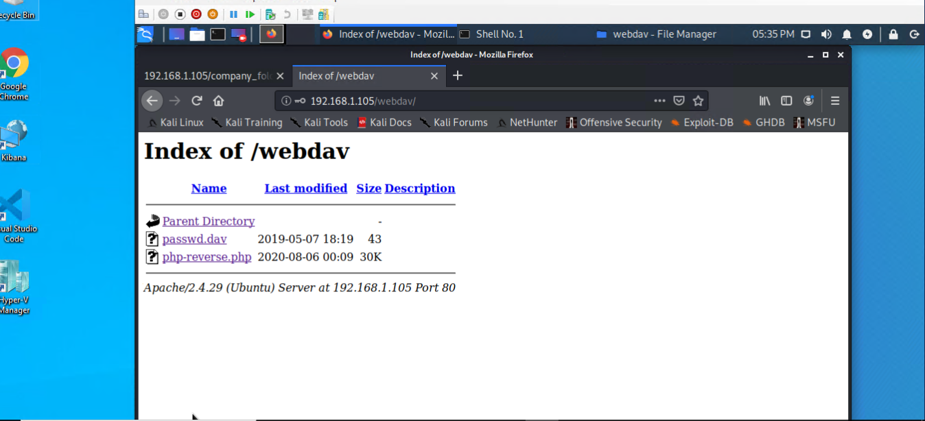
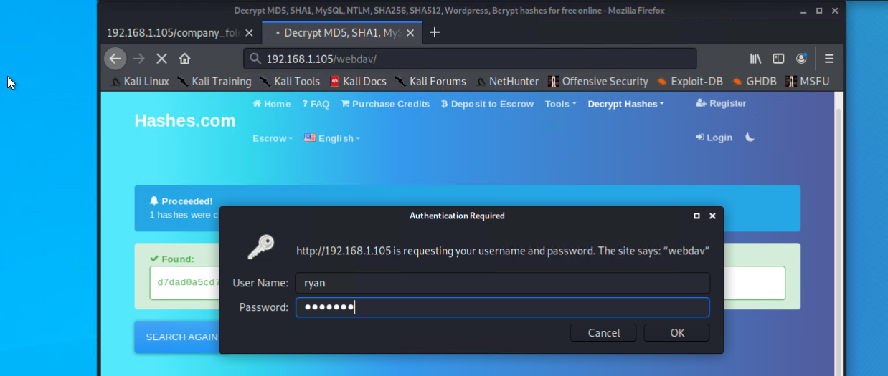

Slide 13
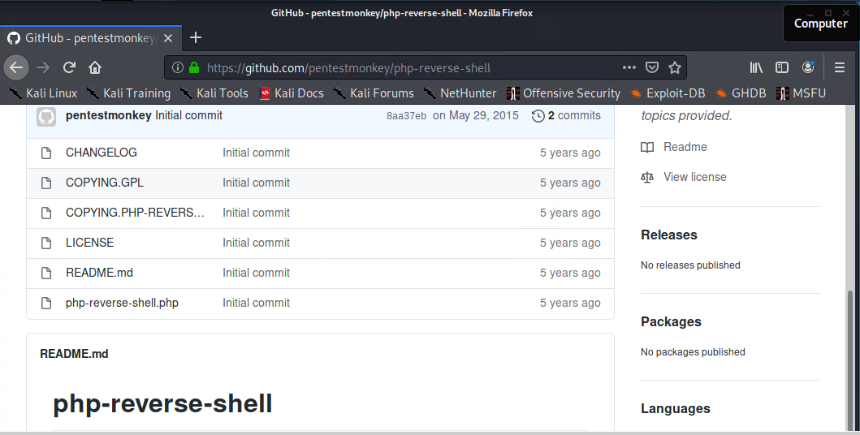
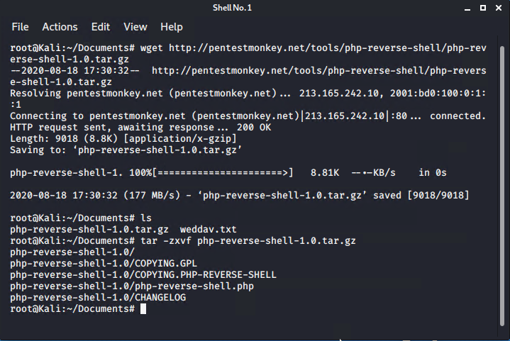

Slide 14

Blue Team
Log Analysis and Attack Characterization
‹#›

Slide 15

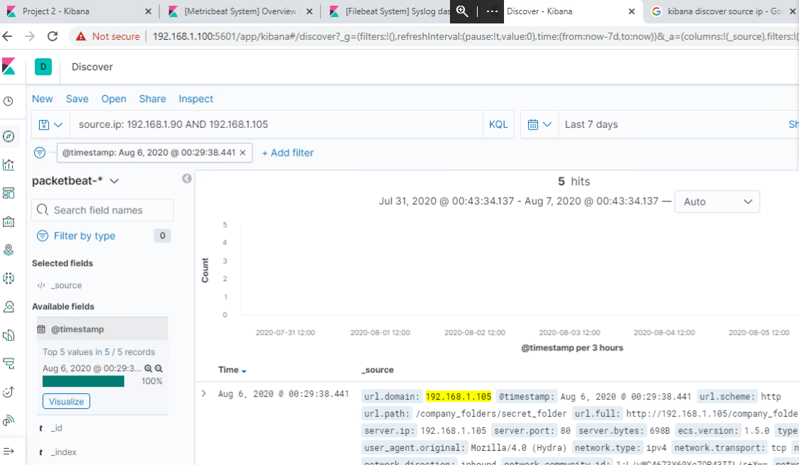
Analysis: Identifying the Port Scan
Port scan occurred Aug 6, 2020 @ 1:29 am
5 packets were sent
[Insert Here]
Include a screenshot of Kibana logs depicting the port scan.

Slide 16
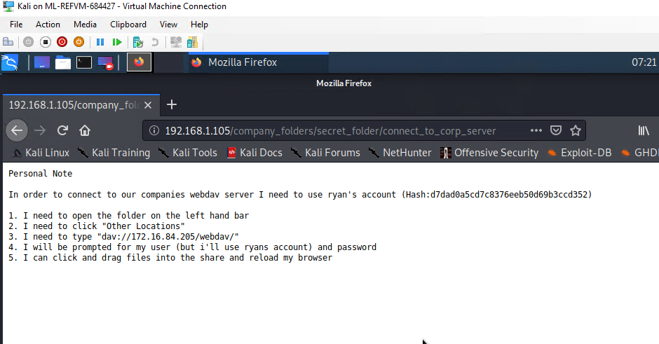
Analysis: Finding the Request for the Hidden Directory
The request occur on Aug 6,2020 at 8:19 pm with 16,000 requests made
Files requested were /Secret_folder/
Once in the secret_folder we found a folder name connect_to_corp_server
Inside were step by step directions to connect to WebDAV along with whos user name we should use.
We found ryans hash ( hidden password) and entered it into a hash decoder to get his password to use.
Once we had username and password we had full access.

Slide 17
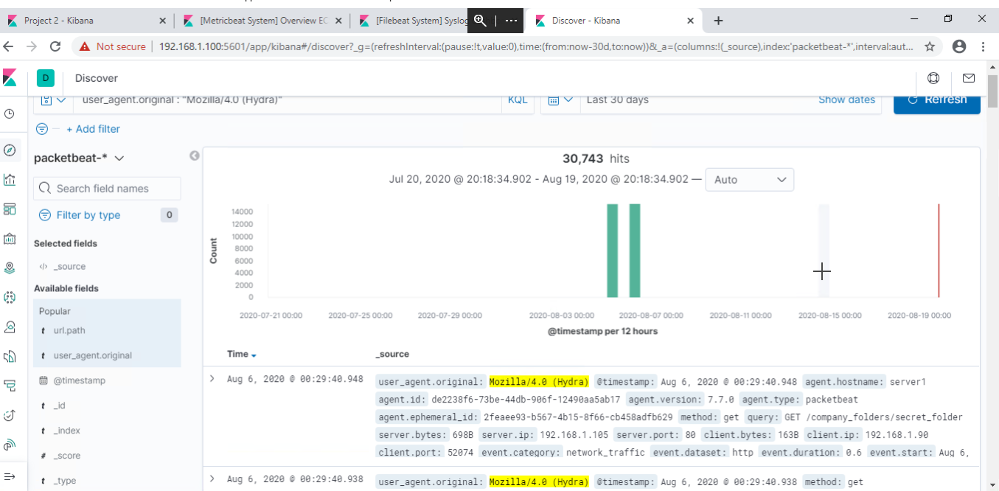
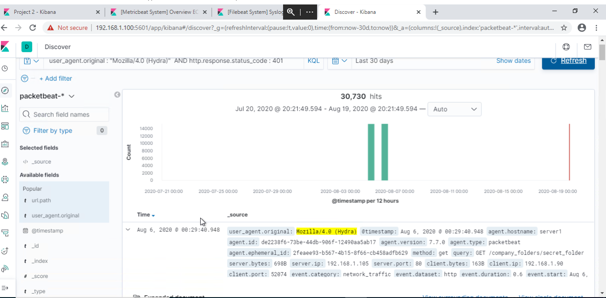
Analysis: Uncovering the Brute Force Attack
30,743 requests were made in the attack
30,730 requests had been made before the attacker discovered the password
[Insert Here]
Include a screenshot of Kibana logs depicting the brute force attack.

Slide 18
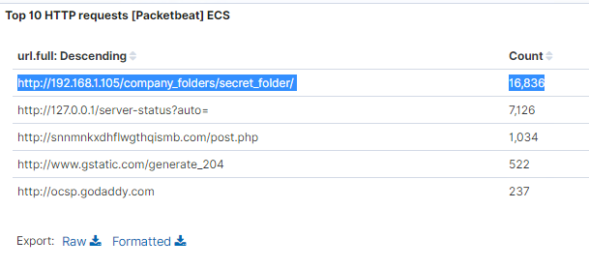
Analysis: Finding the WebDAV Connection
16,832 requests were made to this directory
Requested files from WebDAV were PHP file that was inside the secret folder.

Slide 19
Blue Team
Proposed Alarms and Mitigation Strategies
‹#›

Slide 20
Mitigation: Blocking the Port Scan
Proactive scanning ports once that is in place, the first step is to fix any known vulnerabilities. Next comes audit every open port available externally through the firewall or on the internal network. Services which the public doesn't need to reach should be blocked at the firewall. If employees need to reach them, perhaps they can use the VPN instead. Internal services are often listening even when they aren't being used. They might have been installed or enabled by default, or were enabled due to past use and never disabled.

Slide 21
Mitigation: Identifying Reverse Shell Uploads
There are certain behaviors and characteristics existed in the process that established reverse shell, which are different from other normal processes. TXHunter’s disposable agent runs on the victim computer, collecting process’s behavior and characteristics, analyzing it and detecting reverse shell attacks. The following lists its hunting result of detecting reverse shell attack, where you can see the attacking sequence along with processes and time.

Slide 22
Mitigation: Finding the Request for the Hidden Directory
Send an Email alert if an unknown MAC address (new device) request the directory.
Have a list of all device MAC address that connect to companies servers.
A MAC address is given to a network adapter when it is manufactured. It is hardwired or hard-coded onto your computer's network interface card (NIC) and is unique to it.

Slide 23
Mitigation: Preventing Brute Force Attacks & Detecting the WebDAV Connection
Set up alarm protocols that will notify IT staff by email when an accounts locked out due to 5 failed login attempts. For a staff member to access the account they need to call IT verify them self to get account unlocked
Limit password attempts to 5
Two-Factor Authentication
16 character passwords
Change password every 30 days

Slide 24
Mitigation: Detecting the WebDAV Connection
Set up alarm protocols that will notify IT staff by email when an accounts locked out due to 5 failed login attempts. For a staff member to access the account they need to call IT verify them self to get account unlocked
Limit password attempts to 5
Two-Factor Authentication
16 character passwords
Change password every 30 days

